Slide 1
Pig Latin - Not so Foreign Language
Christopher Olston, Benjamin Reed, Utkarsh Srivastava,
Ravi Kumar, Andrew Tomkins (Yahoo! Research)
Presented By :
Khushbu Kolhe
Lakshmi Chamala
Gulnoza Khakimova
Dileep Kumar Durgam

Slide 2

Introduction
Internet Companies need huge amount of data.
Need to add ad-hoc analysis of extremely large datasets because innovation depends on able to analyse terabytes of data.
Analysis of this data is the innermost loop of the product improvement cycle.
Data Analyst are skilled programmers.
The sheer size of these data sets dictates that it be stored and processed on highly parallel systems eg . Teradata , Oracle RAC , Netezza which provide SQL query interface and hides the complexity of the system.
Such products are very expensive at the web scale.
Besides, declarative style is uncomfortable for procedural programmers
Notes:
Developers at top web properties trying to make their product better.
Data drives decision in these organizations
They have massive, un-indexable datasets to work with.
And they want to do ad-hoc analysis on them.
Map-reduce over a parallel cluster solves the problem quite efficiently.
Takes advantage of the massive parallelism inherent in the data analysis problem.

Slide 3
Map reduce.
Solution would be map- reduce.
Map : Performs the group by
Reduce : Performs the aggregation
These are two high level declarative primitives which enables parallel processing over a cluster of machines
Appealing to programmers because the code can be written in any language of choice without worrying about parallelism.

Slide 4
Disadvantages of Map Reduce.
Can be difficult to make queries fit into the two-stage “map then reduce” model.
Even common operations such as Join, filter, projection, aggregates, sorting, distinct etc must be coded by hand.
Hence difficult to reuse and maintain and in which semantics of tasks are obscured.
Opaque nature of map and reduce functions impedes the ability of the system to perform optimizations.

Slide 5
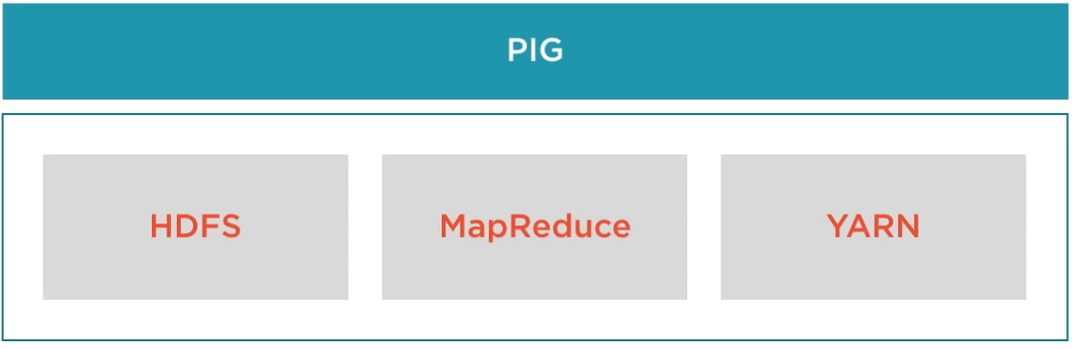
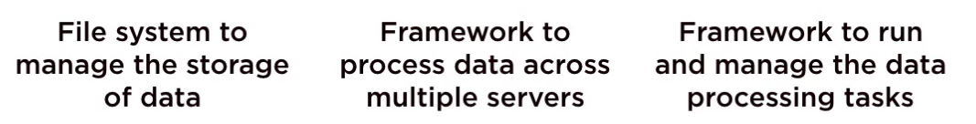
Introduction to Pig Latin.
High level Scripting language in the spirit of SQL and low level procedural programming in spirit of Map Reduce. Its a data flow language.
Part of Hadoop Eco-System. It runs on top on Hadoop distributed framework.
It works well with unstructured and unconsistent data.
Can work directly on files in HDFS.

Slide 6
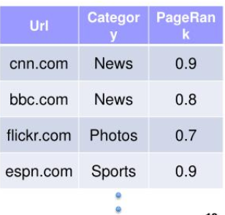
Example of Pig Latin
Suppose we have a table urls: (url, category, pagerank). For each sufficiently large
category, find the average pagerank of high-pagerank urls in that category.
SQL: -
SELECT category, AVG(pagerank)
FROM urls WHERE pagerank > 0.2
GROUP BY category HAVING COUNT(*) > 1000000
Pig Latin:-
good_urls = FILTER urls BY pagerank > 0.2;
groups = GROUP good_urls BY category;
big_groups = FILTER groups BY COUNT(good_urls) > 1000000;
output = FOREACH big_groups GENERATE category, AVG(good_urls.pagerank);

Slide 7
More on Pig Latin
Pig Latin is a sequence of steps where each step carries out a single data transformation.
Transformations are high level e.g filtering, sequencing , grouping much like sql.
This is appealing to the developers.
Moreover it is similar to dataflow graph thus making it easier to understand and execute how their data processing task is executed.
Pig Latin support a flexible , fully nested data model , extensive support for user defined functions and ability to operate over plain input files.
It also comes up with a novel debugging environment which is useful in dealing with enormous datasets.

Slide 8
Features and Motivation : Dataflow Language
Goal is to be appealing to experienced programmers for performing analysis of extremely large data sets.
Pig Latin has a number of features that might seem surprising when viewed from a traditional database and SQL perspective.
Consider an example to find the set of urls of pages that are classified as spams but have high page rank score.
spam_urls = FILTER urls BY isSpam(url);
culprit_urls = FILTER spam_urls BY pagerank > 0.8;
Optimization is available to the system since the filters are not hidden in map or reduce function . Then reordering and Optimization would be effectively impossible.

Slide 9
Dataflow language
Pig Latin Program :
good_urls = FILTER urls BY pagerank > 0.2;
groups = GROUP good_urls BY category;
big_groups = FILTER groups
BY COUNT(good_urls) > 1000000;
output = FOREACH big_groups
GENERATE category,
AVG(good_urls.pagerank);
Filter urls by pagerank>0.2
Group by Category
Filter Category by count > 1000000
Foreach category generate avg.pagerank

Slide 10
Quick start and interoperability
Data I/O is greatly simplified in pig
Designed to support ad-hoc data analysis.
Why RDBMS have stringent requirements?
To enable transactional consistency guarantees.
To enable efficient point lookup (using physical indexes).
To enable data curation on behalf of the user.
To enable other users figuring out what the data is, by studying the schema.
https://www.slideshare.net/michiard/pig-48345690

Slide 11
WHY IS pig so flexible?
•Supports read-only workloads.
•Supports scan-only workloads.
•No need for transactions nor indexes.
•Schemas are optional.

Slide 12
Why data curation is not required
Very,often pig is used for AD-HOC data analysis.
Work on temporary data sets and then throw them out!
Curation is an overkill…
Why Schemas are optional
Can apply one on the fly, at runtime or not at all.
Can refer to fields using positional notation.
E.g., good_urls = FILTER urls BY $2 > 0.2;

Slide 13
Nested data model
•Easier for programmers to think about nested data structures.
•Example: Capture information of each pig in a collection of pig farms.(
• Map<pigFarmId,Set<pig>>
(Map<documentid,set<positions>> for each term.

Slide 14
Nested data model
•Instead,RDBMS, allows only flat tables…
•Only automatic fields as columns
•Require normalization
Ex:From the above example creating two tables
term_info: (termid, termstring,……)
position_info: (termid,documentid,position)
•occurrence inf obtained by joining on termid, and grouping on termid,documentid

Slide 15
Nested data model
•Pig Latin offers a flexible, fully nested data model and allows complex, non-atomic data types as field or table.
E.g., Set, Map,Tuple
•Some reasons for having a nested data model:
1.closer to how programmers think and thus, much more natural to them than normalization.
2.allows programmers to easily write a rich set of user-defined functions.

Slide 16
Nested data model
3. Data is often stored on disk in an inherently nested fashion.
Ex: A web crawler might output for each url, the set of outlinks from that url.
4. A nested data model allows to have a algebraic language!
Ex:Each tuple output by group has a one non-atomic field,a nested set of tuples from the same group.
5.Nested data makes life easier when writing user defined functions.

Slide 17
Nested data model
•Custom processing is often predominant
E.g., users may be interested in processing natural language stemming of a search term or, tagging urls as spam.
•All commands of pig latin can be customized
Grouping, filtering, joining, per-tuple processing
•Udf's supports the nested data model
Input and output can be non atomic.

Slide 18
UDFs as First-Class Citizens
Assume we want to find for each category,the top 10 urls according to pagemark
groups = GROUP urls BY category;
output = FOREACH groups GENERATE category,
top10(urls);
Here, top10() is a UDF that accepts a set of URLs
outputs a set containing the top 10 URLs by pagerank for that group.
The final output contains non-atomic fields: there is a tuple for each category, and one of the fields is the set of top 10 URLs.

Slide 19
UDFs as First-Class Citizens
UDFS can be used in all pig latin constructs.
Practical notes
• UDFs can be written in Java,python and javascript.
With streaming,we can use also c/c++,python,......

Slide 20
Handling parallel execution
Pig and pig latin are geared towards parallel processing
of course, the underlying execution engine is map reducing.
Pig latin primitives are chosen such that they can be easily parallelized.
Other primitives that do not lend themselves to efficient parallel evaluation have been deliberately excluded.
They can still be carried out by UDFs. The user is then responsible for how efficient his programs are and whether they will be parallelized.
Users may specify parallelization parameters at run time
Q1: Can u specify the no:of maps?
Q2: Can u specify the no:of reducers?

Slide 21
Debugging environment
Getting a data processing program right usually takes many iterations. With web-scale data, a single iteration can take many minutes or hours.
The usual run-debug-run cycle can be very slow and inefficient.
Pig comes with a novel interactive debugging environment that generates concise example data tables illustrating the output of each step of the user's program.
These step by step procedure helps in detecting the errors early(in first step),and also in pinpointing the step that has errors.

Slide 22
Important Features of PIG
•First most important feature is Nested Data Model
•Second most important feature is Dataflow language.

Slide 23
Data Model
Atom - contains a simple atomic value such as a string or number
Tuple - sequence of fields, each of them can be any type
Bag - collection of tuples with possible duplicates, schema is flexible and tuples can be nested
Map - collection of data items, each item has a key, which needs to be data atom and constituent data item’s schema is flexible
Atom | Tuple | Bag | Map
‘alice’ | (‘alice’,’laker’) | { ( ‘alice’ , ’lakers’ ) } { (‘alice’, (‘iPod’, ‘apple’) ) } | { (‘lakers’) } ‘Fan of’ -> { (‘iPod’) } ‘Age’ -> 20

Slide 24
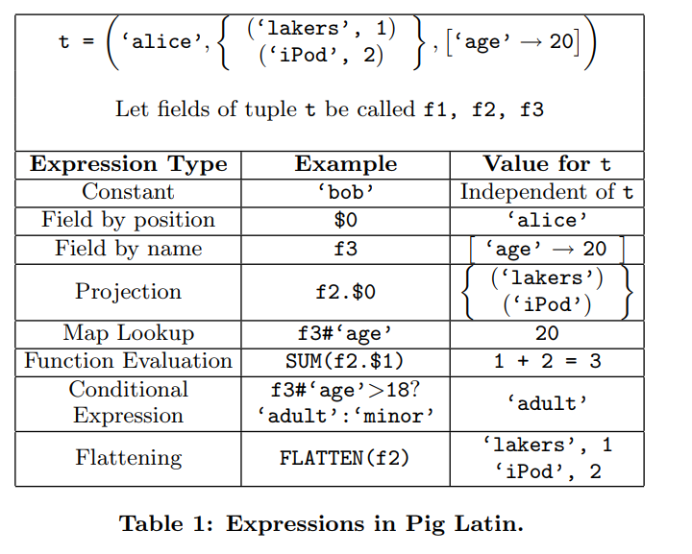
Data Model
Table 1 shows the expression type in
Pig Latin and how they operate. Data
model is flexible and allows arbitrary
nesting.

Slide 25
Specifying Input Data: LOAD
The first step is to specify input data file and how it is converted to Pig’s
data model.
Input file contains a sequence of tuples, i.e., a bag.
Load command is used to perform this step.
queries = LOAD ‘query_log.txt’ USING myLoad()
AS (userId, queryString, timeStamp)

Slide 26
Specifying Input Data: LOAD
Return value of LOAD command is a handle to a bag which is assigned to a variable further it can be used as an input.
Bag handles in Pig is only logical - LOAD command only specifies in input file and how it should be read.
Data is not read and no processing is done until user asks for output (STORE command)

Slide 27
Per-tuple processing: FOREACH
FOREACH is command which is used to apply some operation on each tuple of data set.
expended_query = FOREACH query
GENERATE userId, expandQuery (queryString) ;
Semantics of FOREACH command are such that there can be no dependence between the processing of different tuples of the input, which permits efficient parallel implementation.

Slide 28
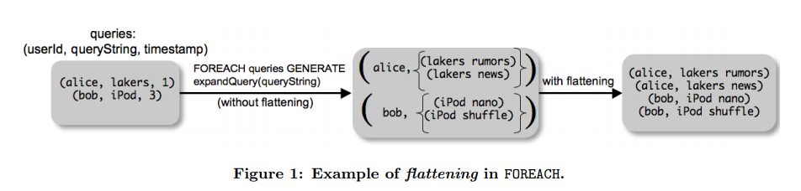
Flatten expression type
Flattening is used when we want to eliminate nesting in data, query string into separate tuples.
expended_query = FOREACH query GENERATE userId,
FLATTEN (expandQuery (queryString)) ;

Slide 29
Discarding Unwanted Data: FILTER
FILTER is used to discard unwanted data.
Real_query = FILTER queries BY userid neq ‘bot’
Since arbitrary expressions are allowed, we can use UDFs while filtering.
Real_query = FILTER queries BY NOT isBot (userid)

Slide 30

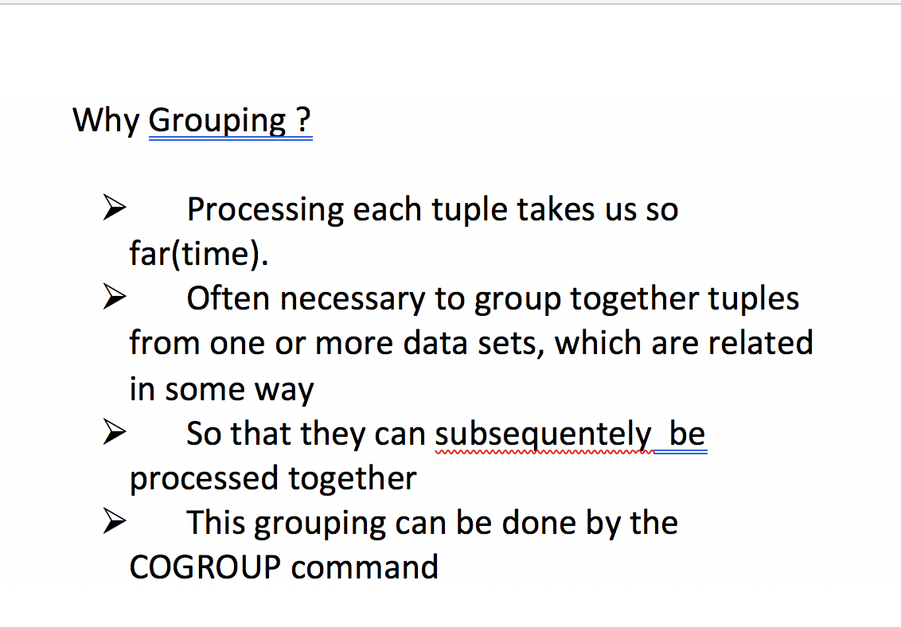
Speaking Pig Latin

Slide 31
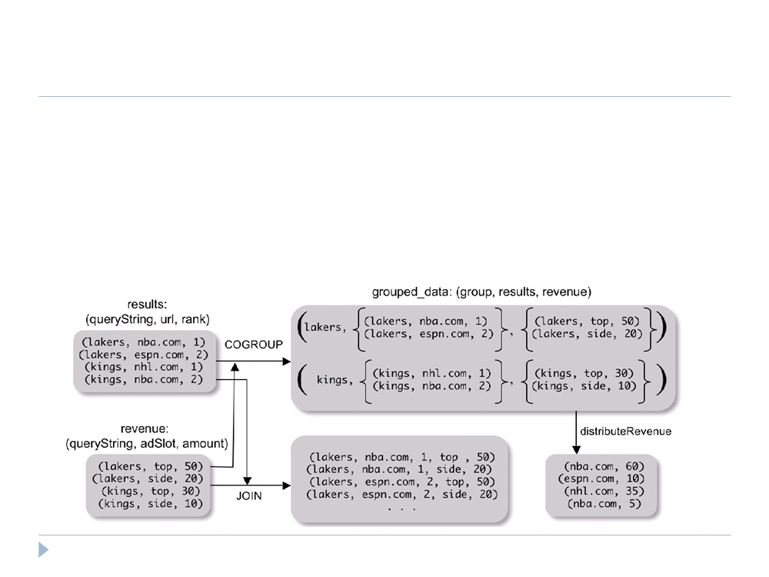
Speaking Pig Latin
❝ COGROUP
❝ Group two datasets together by a common attribute ❝ Groups data into nested bags
grouped_data = COGROUP results BY queryString, revenue BY queryString;
20

Slide 32
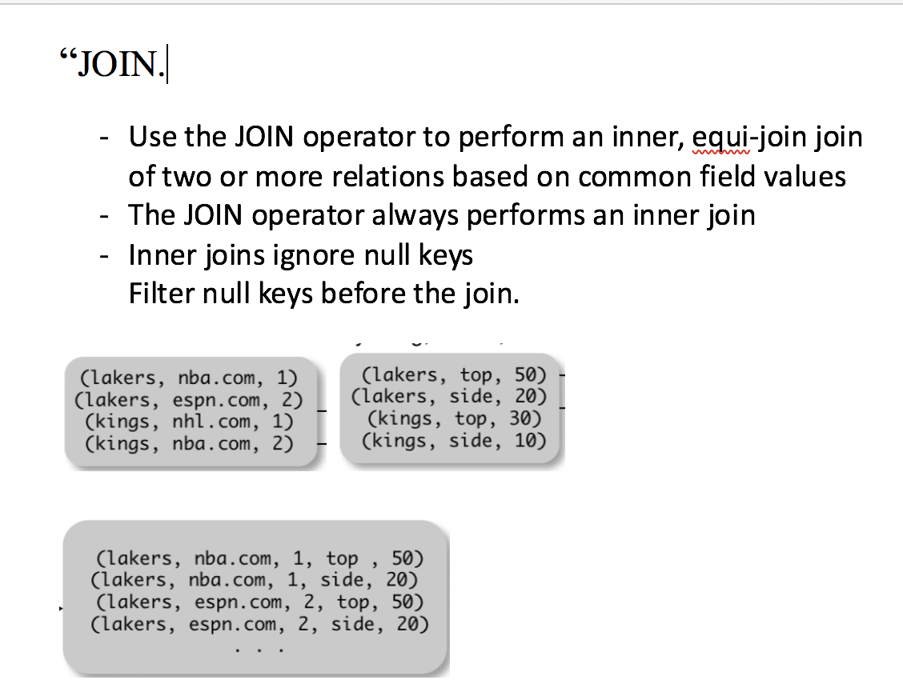
Speaking Pig Latin

Slide 33
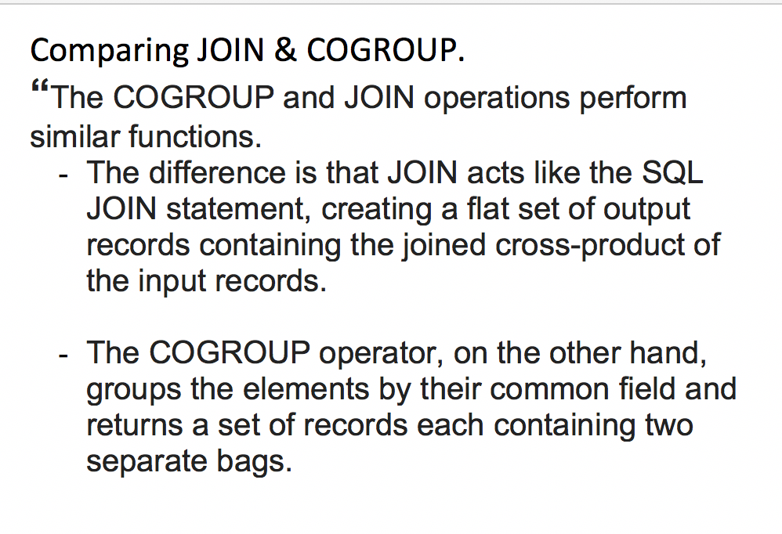
Speaking Pig Latin

Slide 34
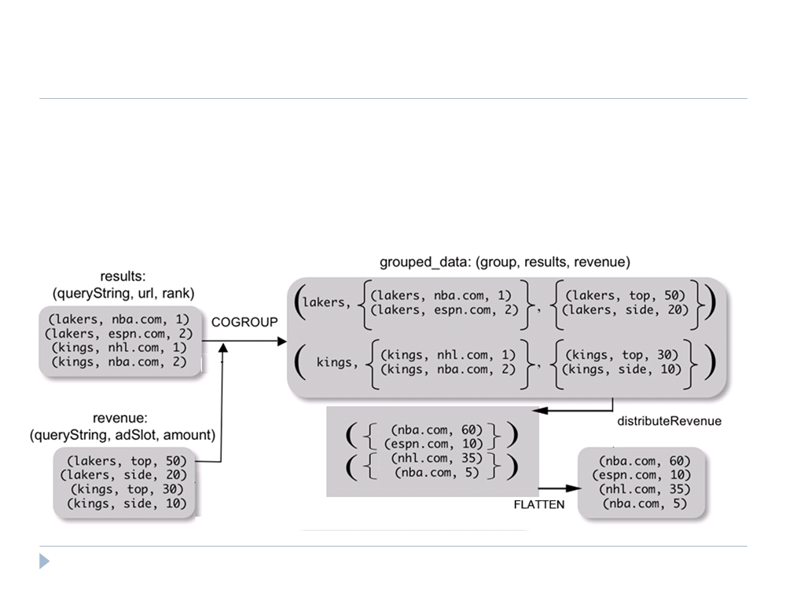
Speaking Pig Latin
❝ Why COGROUP and not JOIN?
url_revenues =
FOREACH grouped_data GENERATE
FLATTEN(distributeRev(results, revenue));
21

Slide 35
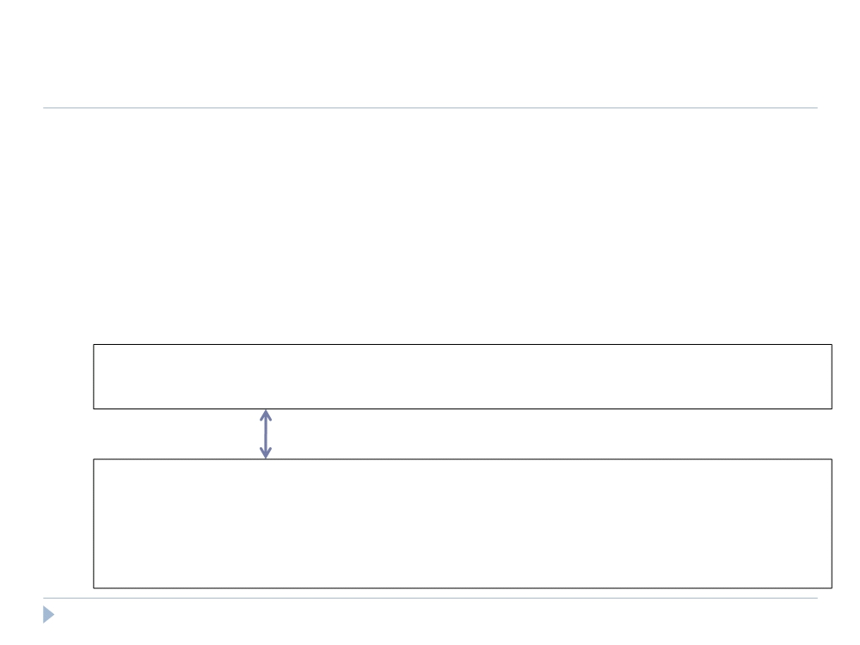
Speaking Pig Latin
❝ Why COGROUP and not JOIN?
❝ May want to process nested bags of tuples before taking the cross product.
❝ Keeps to the goal of a single high-level data transformation per pig-latin statement.
❝ However, JOIN keyword is still available:
JOIN results BY queryString, revenue BY queryString;
Equivalent
temp = COGROUP results BY queryString, revenue BY queryString;
join_result = FOREACH temp GENERATE
FLATTEN(results), FLATTEN(revenue);
22

Slide 36
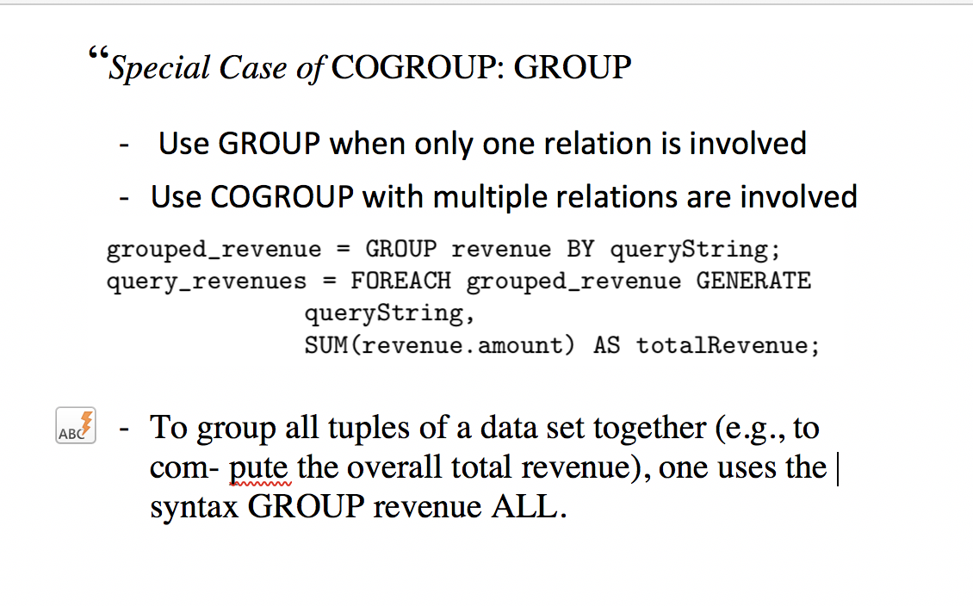
Speaking Pig Latin

Slide 37
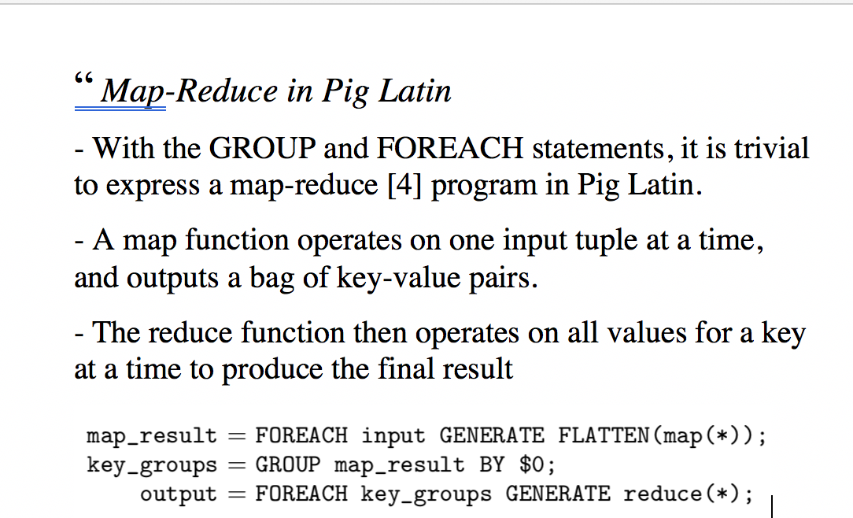
Speaking Pig Latin

Slide 38

Conclusion
❝ Pig is a data processing environment in Hadoop that is specifically targeted towards procedural programmers who perform large-scale data analysis.
❝ Pig-Latin offers high-level data manipulation in a procedural style.
47

Slide 39
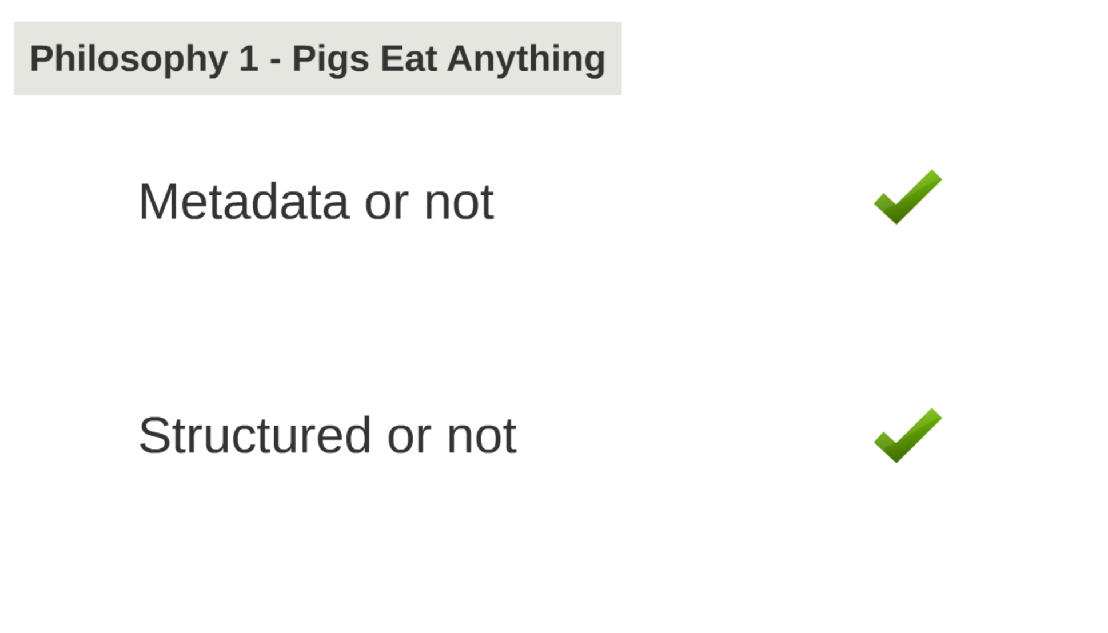

Slide 40
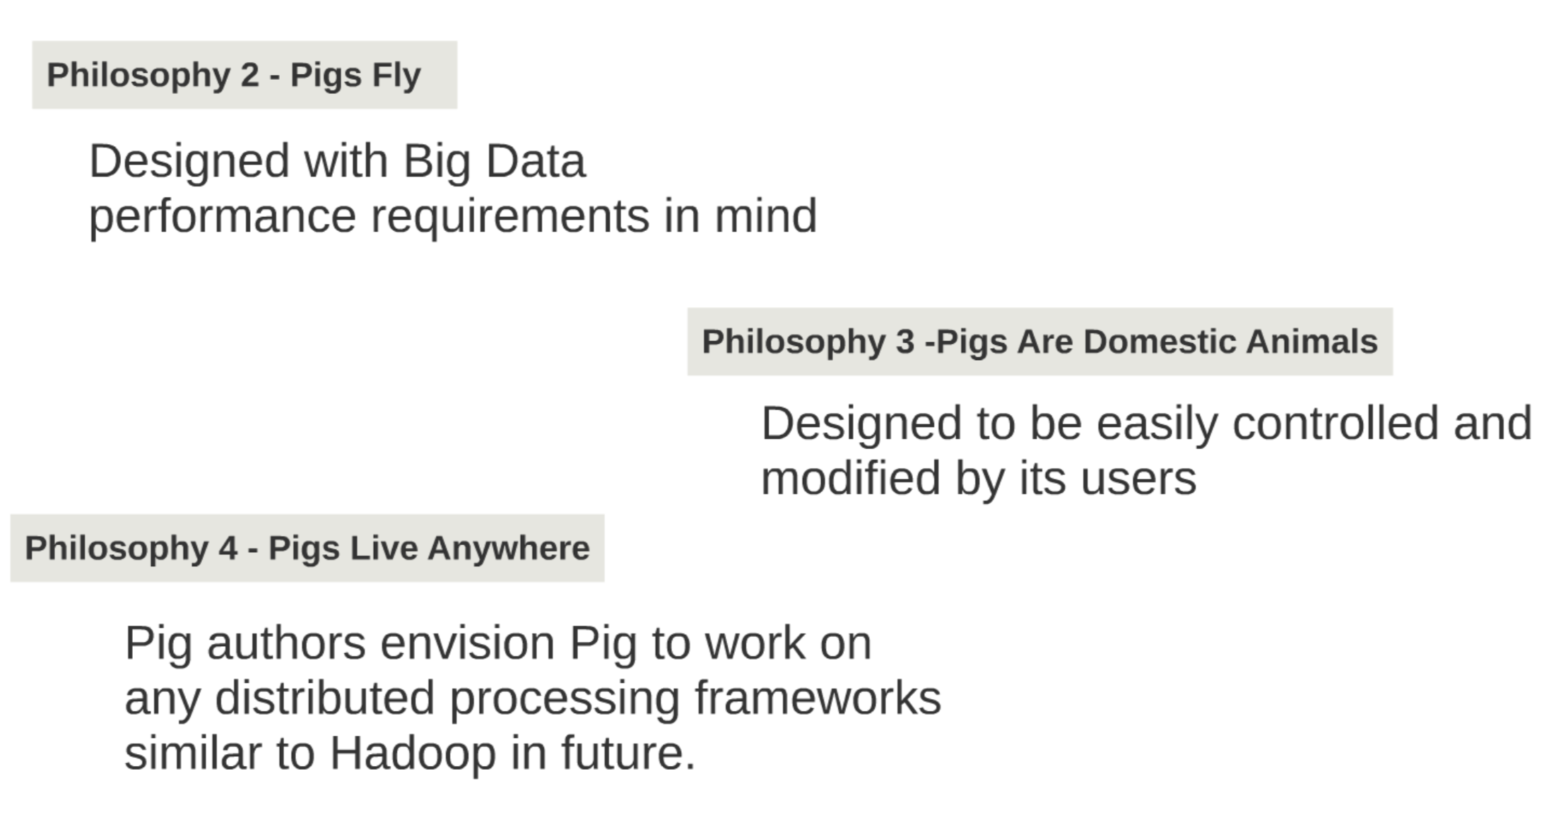

Slide 41
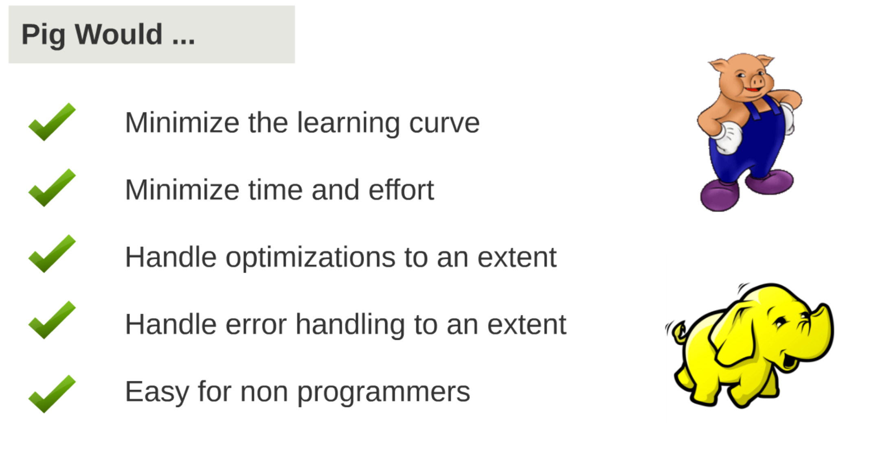

Slide 42

More Info
❝ Pig, http://hadoop.apache.org/pig/ ❝ Hadoop, http://hadoop.apache.org
Anks-
Thay!
48

Slide 43
Thank you...

